Slide 1

New York Stock Exchange
Yukyung Cha, Ismael Isak, Snehal Khatpe, Tashfia Mamun, and Naomi Snider

Slide 2

Problem Definition
Predict the Closing Price of stock to evaluate performance and the overall trend of the market

Slide 3
Dataset and Description
501 companies listed on the NYSE from the year 2010 to 2016
PRICES
Prices is raw as-is daily prices which does not account for stock splits
Records time stamp, open, close, low, high, volume
SECURITY
Description of each company with division on sectors
SPLIT PRICES
Split prices is the same as the prices data, but has been adjusted for stock splits
FUNDAMENTALS
Metrics from SEC 10K filings

Slide 4
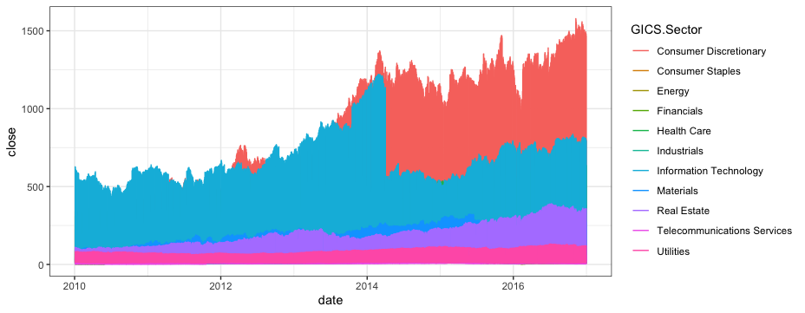
Data Visualization
Biggest growth in consumer discretionary and health sector
Growth slowed down for most industries in 2015
Closing Price for each Industry Per Year
Notes:
In 2014, Google (now Alphabet) split stock 2 for 1, which is causing the variance in the information technology part and also why we chose to use data that was adjusted for splits, instead of just the straight prices

Slide 5
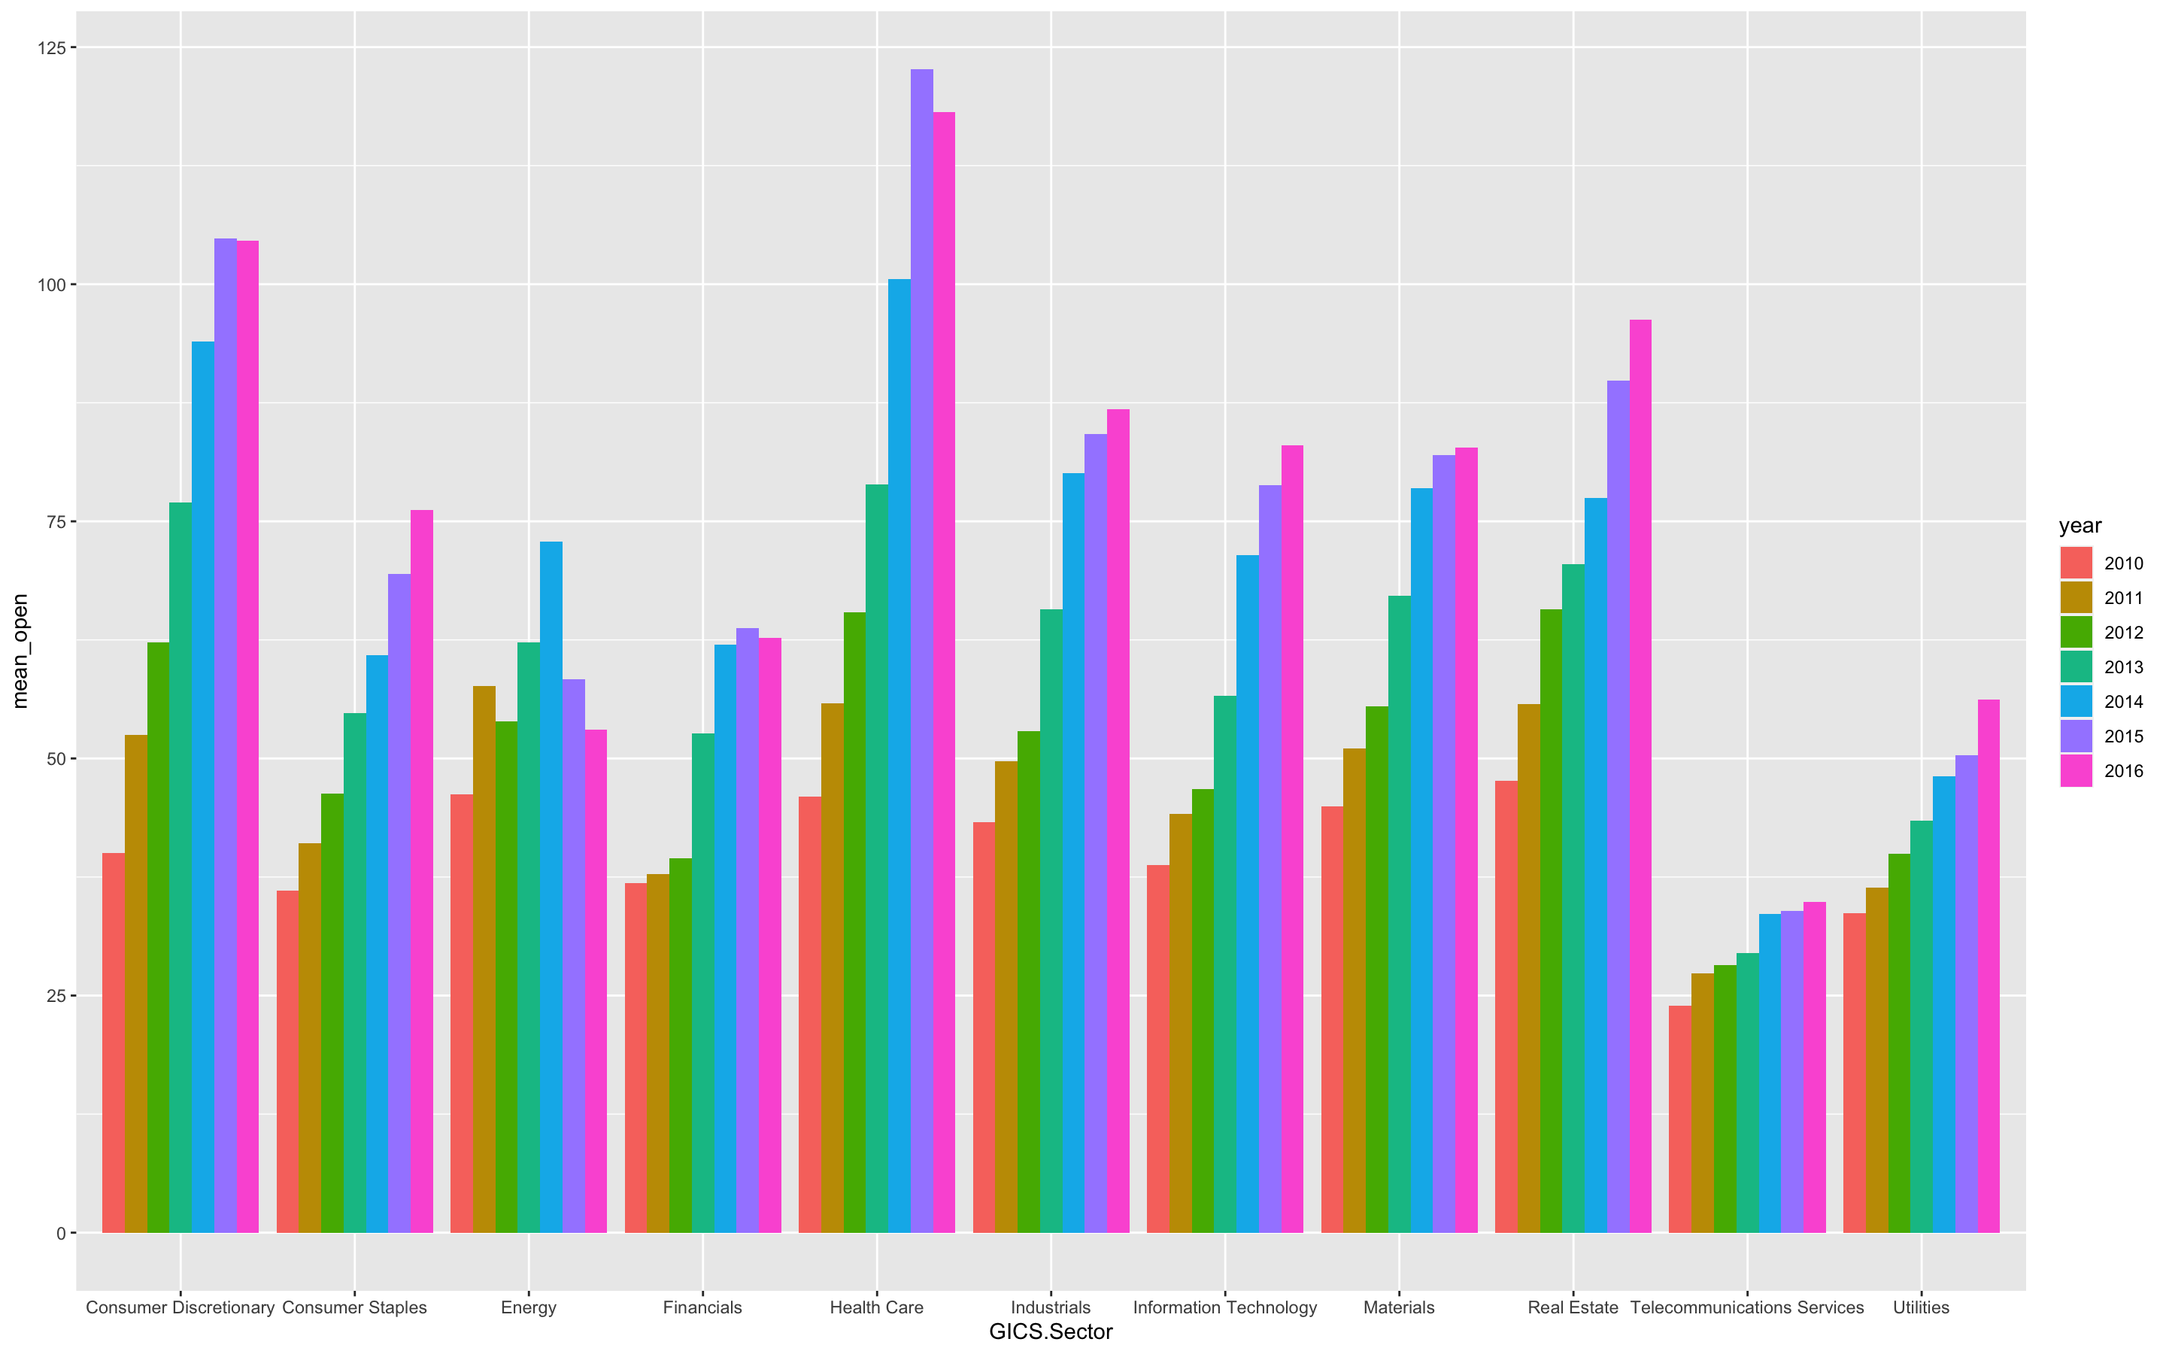
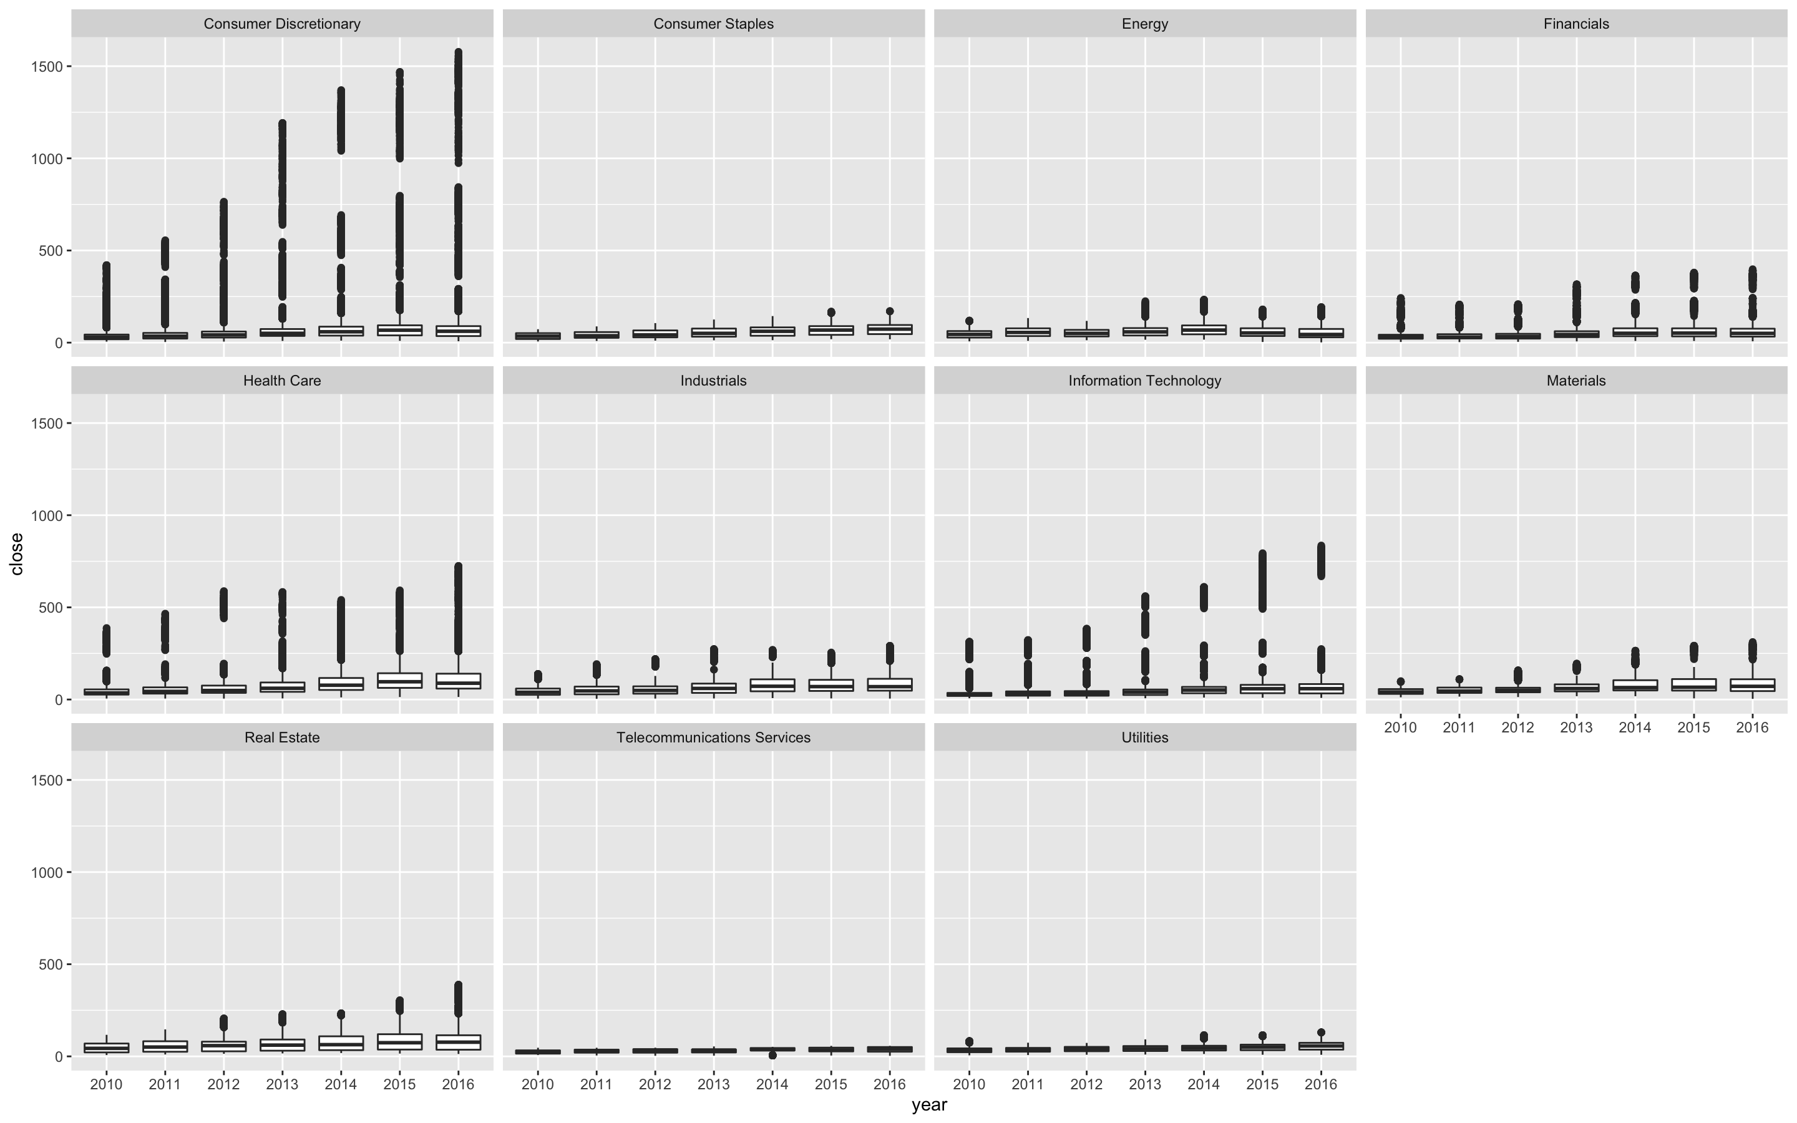
Data Visualization : Analysis by industry
Mean Opening prices each year, grouped by sector
Boxplot of closing prices by industry by year
Biggest growth in consumer discretionary and health sector
Growth slowed down for most industries in 2015

Slide 6
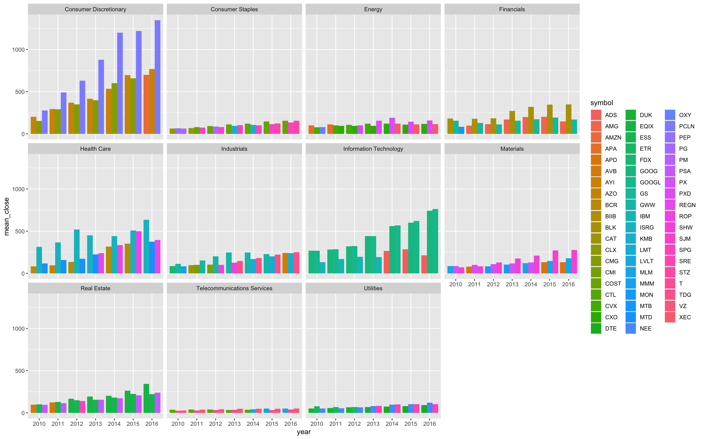
Data Visualization : Analysis by industry
Top 3 has remained consistent mostly
Top 3 companies for each year of each sector ( based on closing price)

Slide 7
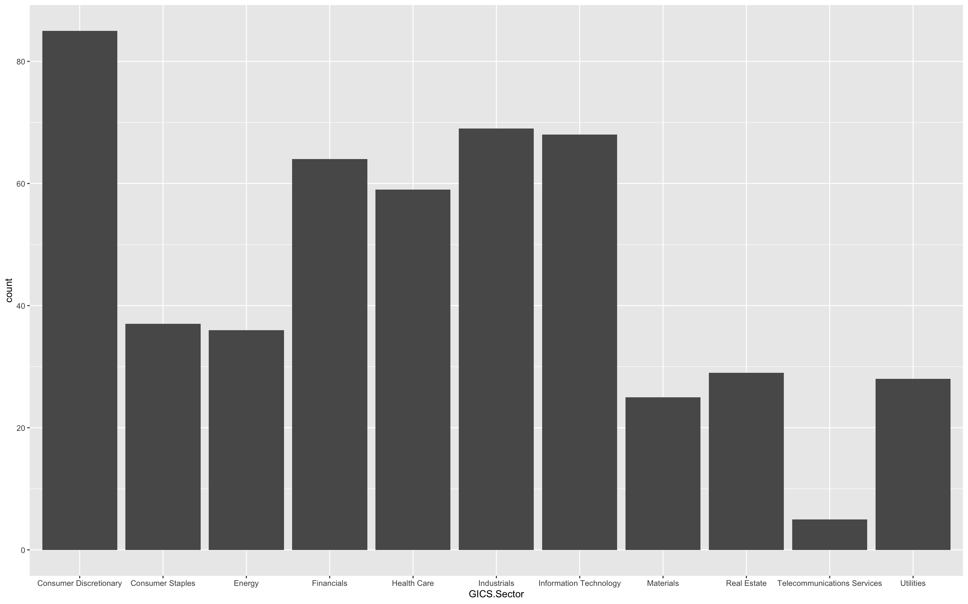
Data Visualization : Analysis by industry
Highest number of companies belong to the Consumer Discretionary industry
Histogram of sectors

Slide 8
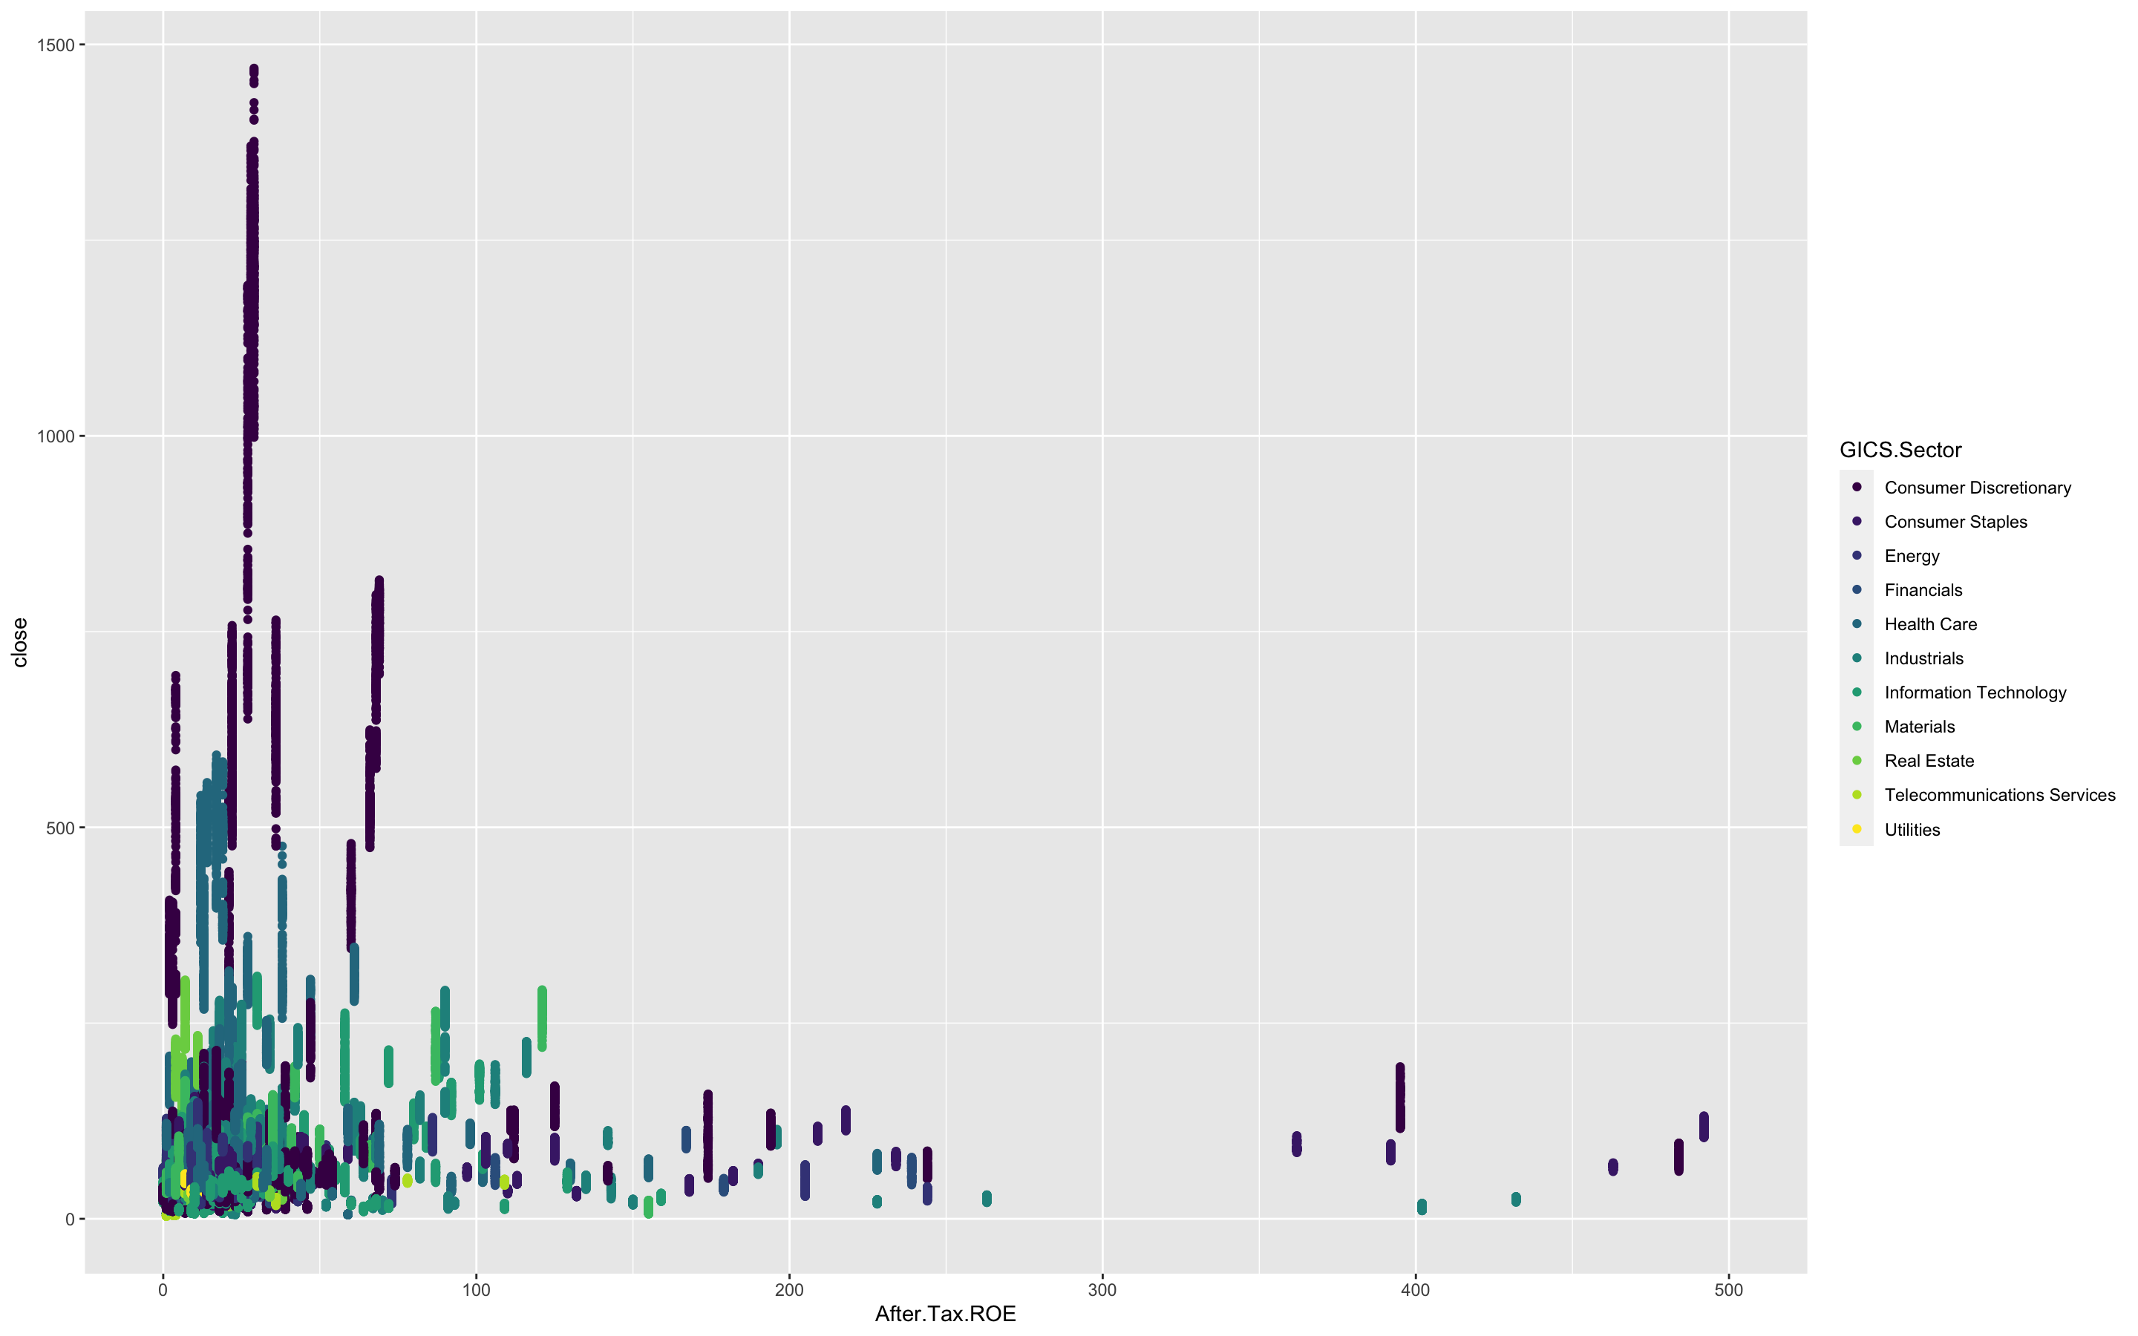
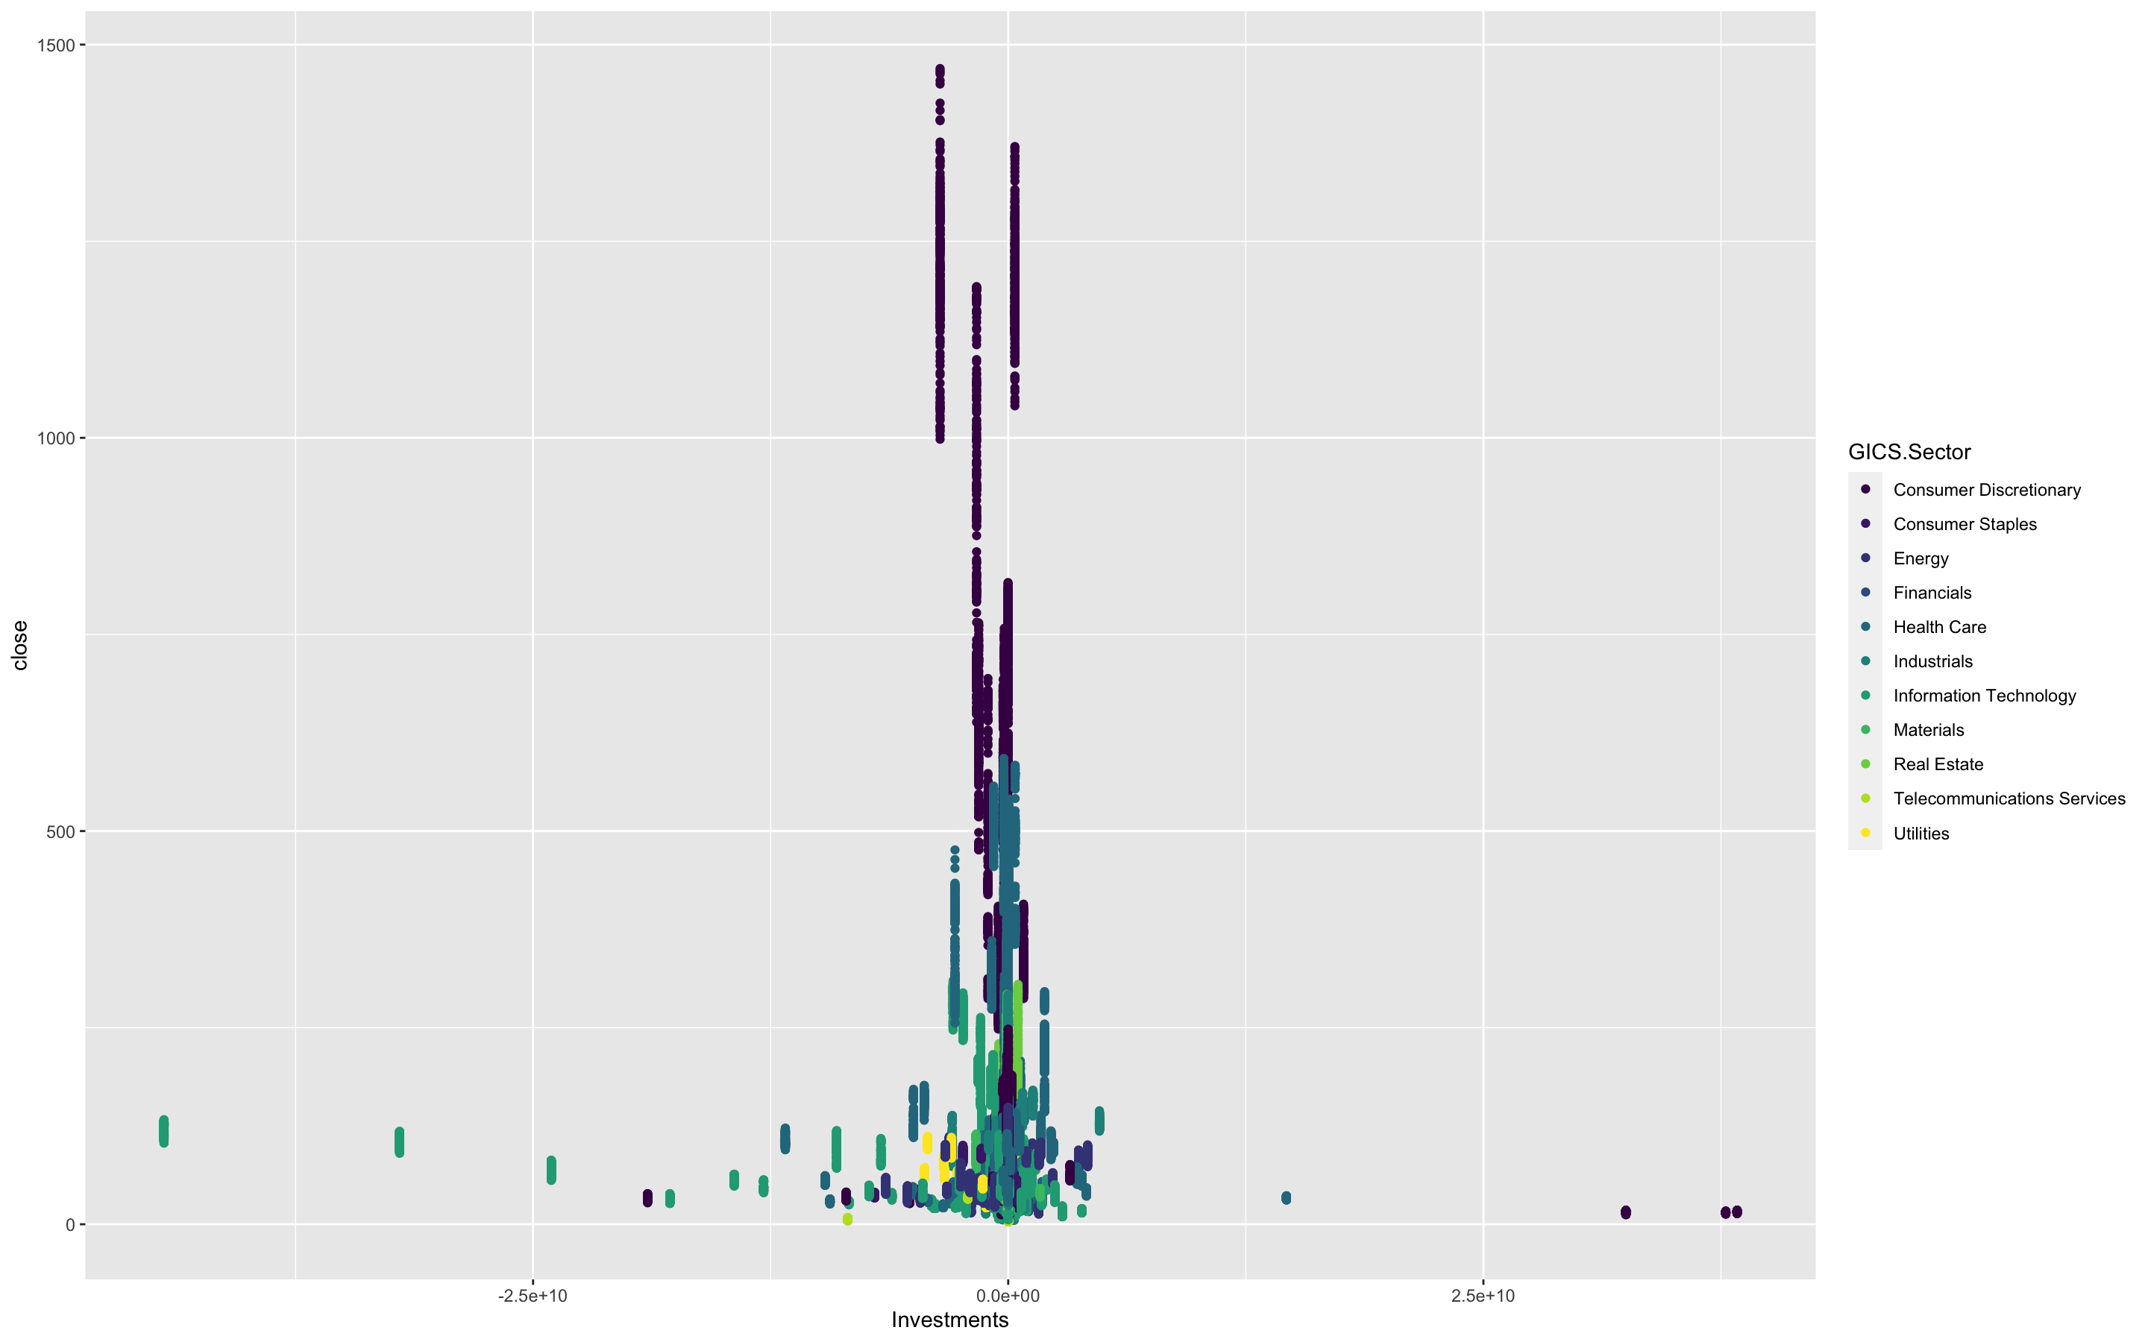
Data Visualization : Analysis on columns
Closing price vs ROE
Closing Price vs ROE
Closing Price vs Investment
No significant linear relationship
Consumer discretionary sector tend to have high stock price and after tax ROE
No significant linear relationship
Investment tended to be centered in the middle

Slide 9
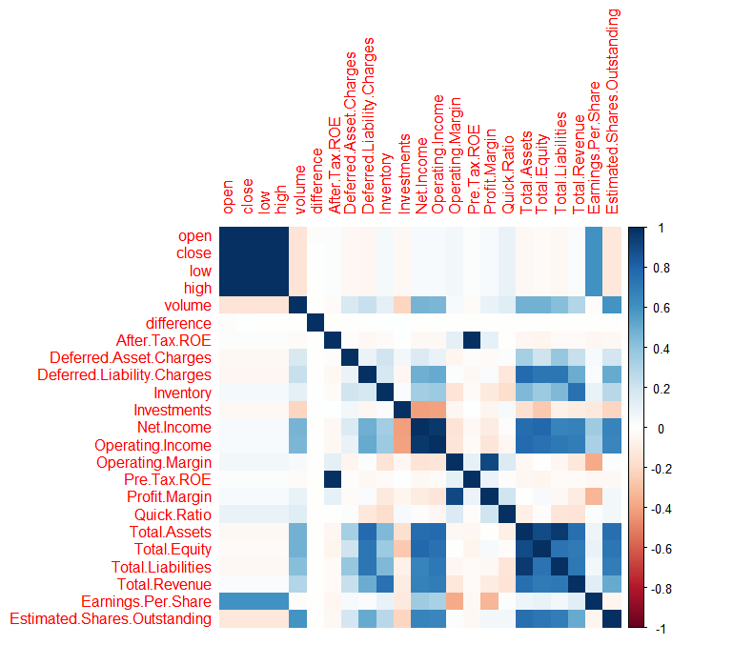
Data Visualization : Analysis on columns
This Cor plot shows that the closing price has significant relationships with ‘open’, ‘close’, ‘low’, ‘high’, ‘volume’, and ‘Estimated Shares.Outstanding’ columns
Core plot for every column

Slide 10
Model Preparation
Objective: Predict Closing stock price based on: Opening stock price, highest and lowest price throughout the day, and volume of stock.
Process: Perform Feature Selection on data, then test multiple models to find the lowest Mean Square Error (MSE).
Once optimal model is selected, improve the model to have better accuracy
Feature Selection: To determine what features/variables to use in the model, forward and backward stepwise regressions were performed.
Similar to the data visualization that was shown closing price had the strongest relationship with opening price, highest and lowest price, and stock volume, which is why these features were selected to predict closing price
Techniques Used/Models Tested: Each of the following models were tested to find the best MSE
Ridge Regression
Lasso Regression
Regression Tree
Neural Network
Linear Regression

Slide 11
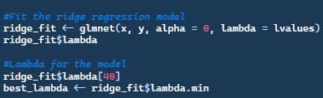
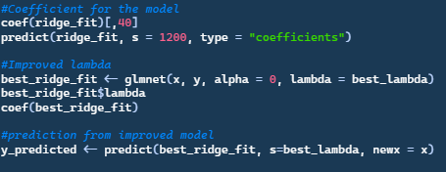
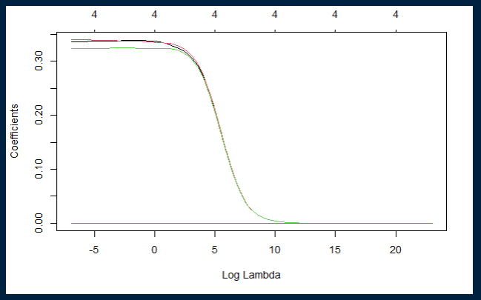
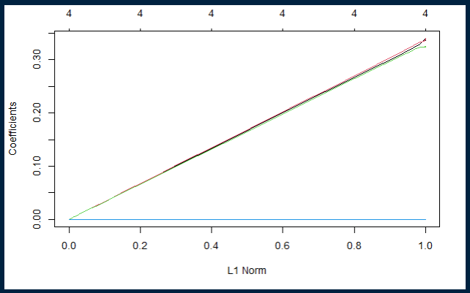
Model Preparation : Ridge Regression
Predicted closing price based on open, low, high, and volume variables
Ridge Trace Plot:
MSE: 366908.4
R squared: -51.20822
Ridge regression is not the best option for the data set due to negative R Squared
Model’s prediction is less accurate than the average value of the data set

Slide 12
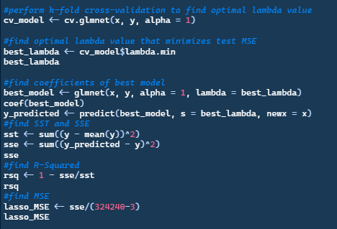
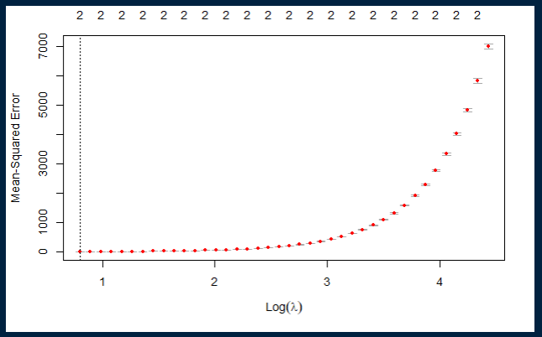
Model Preparation : Lasso Regression
MSE: 7.053108
R squared: 0.9989964
For Lasso Regressions, R squared is not always the best way to check a model’s fit, as there are not many covariates.
Notes:
When comparing to other models, R Squared tends to favor models with lots of covariates.

Slide 13
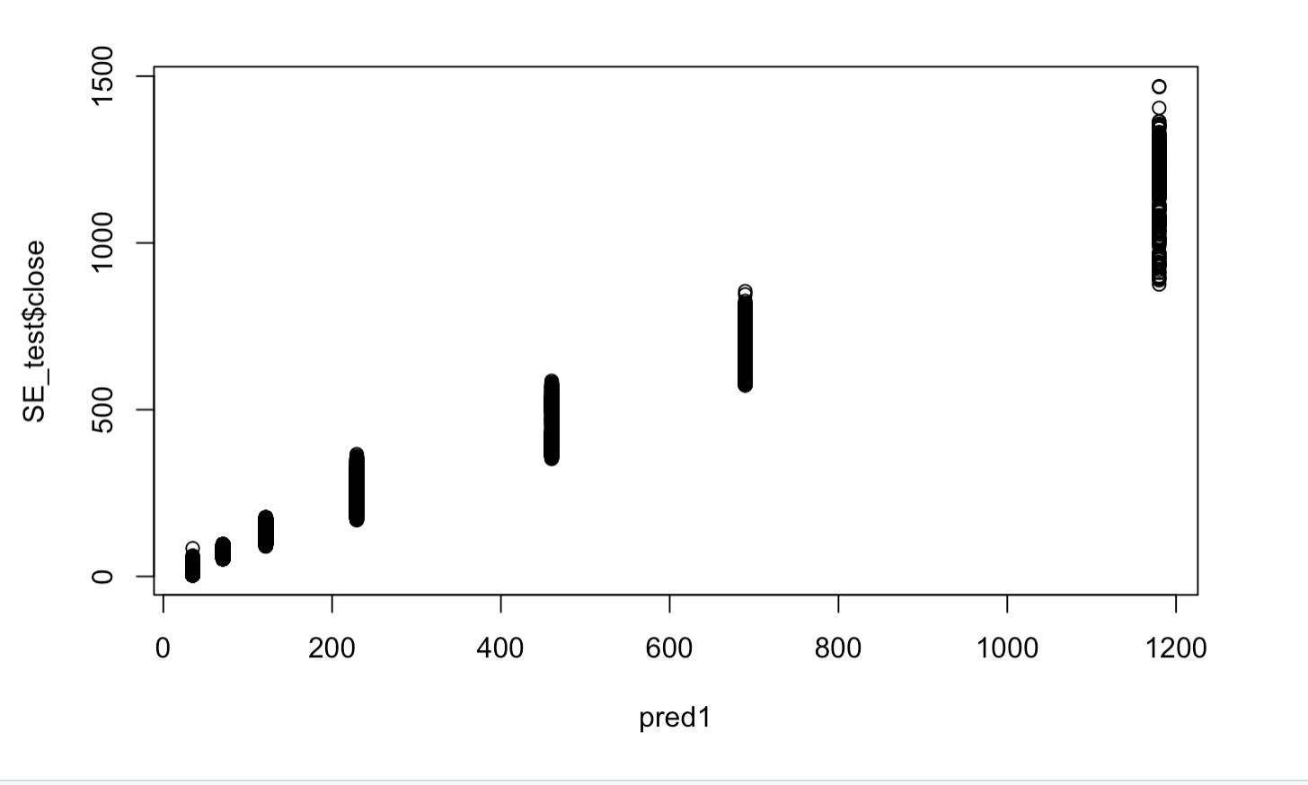
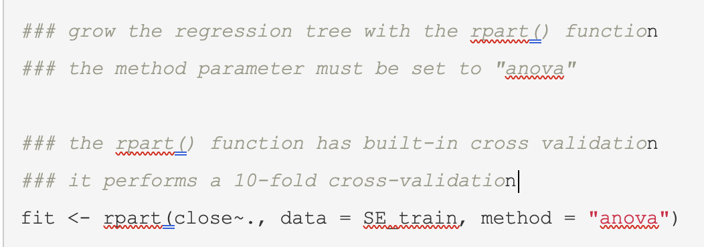
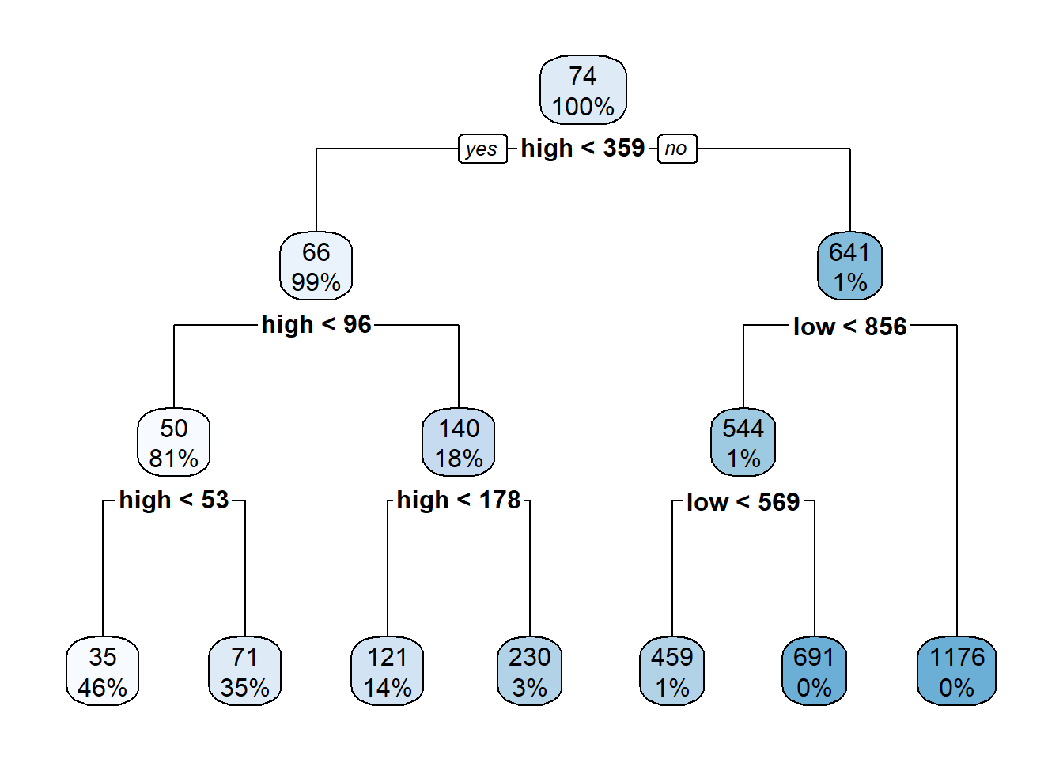
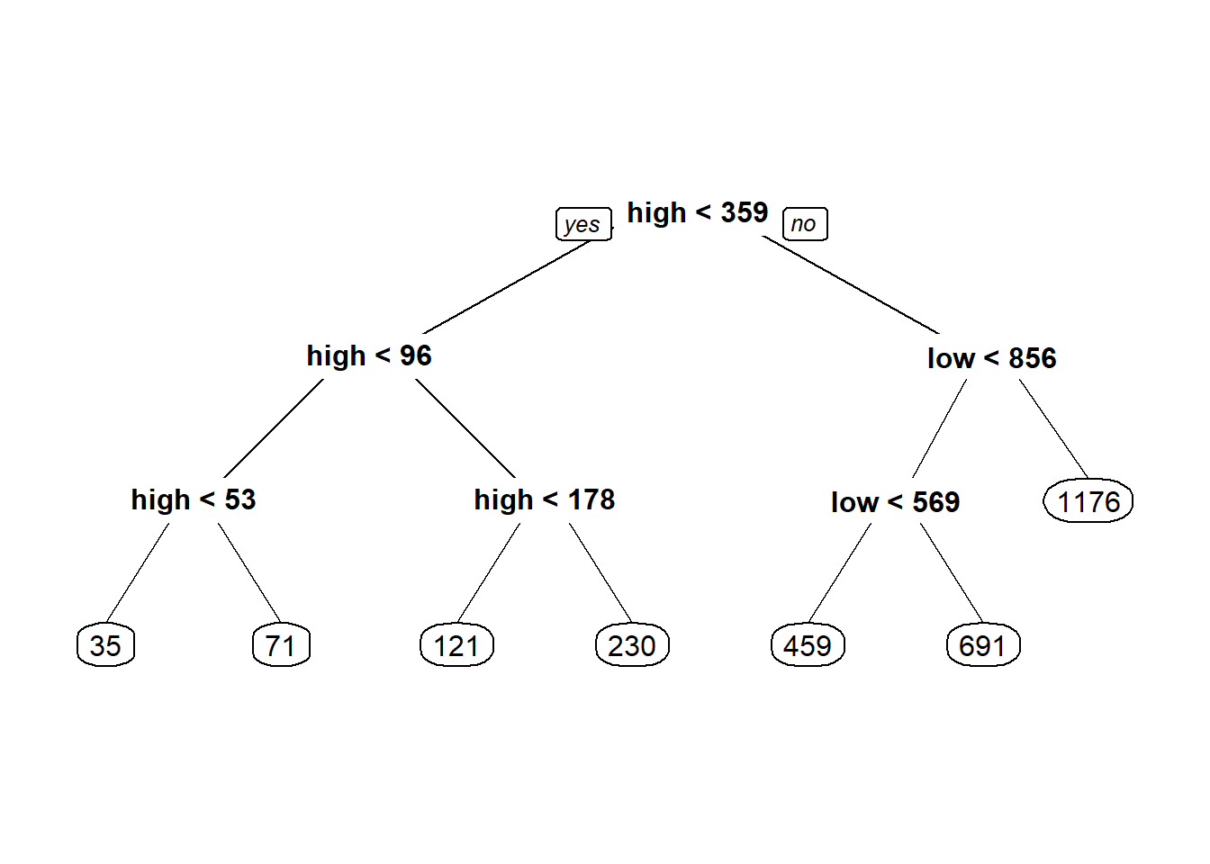
Model Preparation : Decision Tree
Training the model with numeric variables as predictors
MSE: 122.8483
R squared: 0.956
Rsq value indicates it’s a good algorithm for this dataset

Slide 14
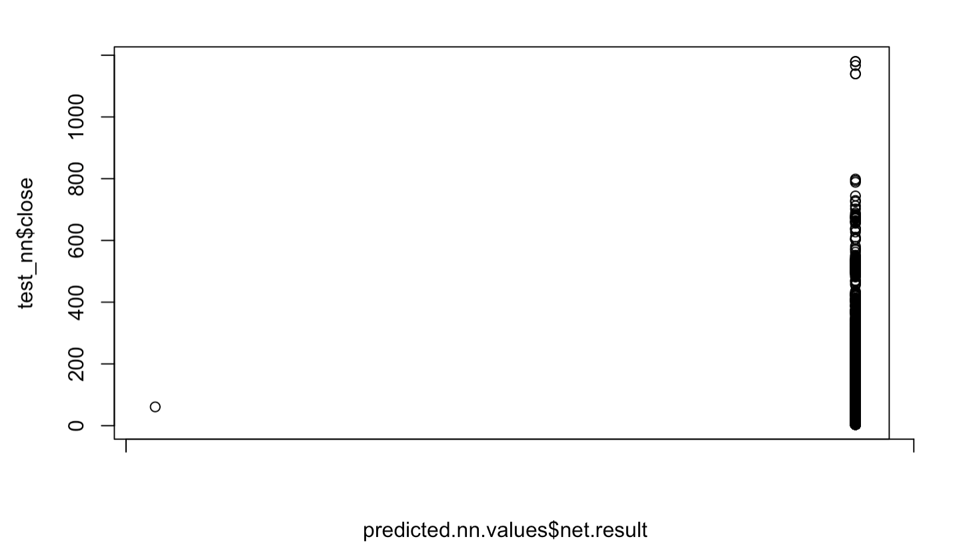
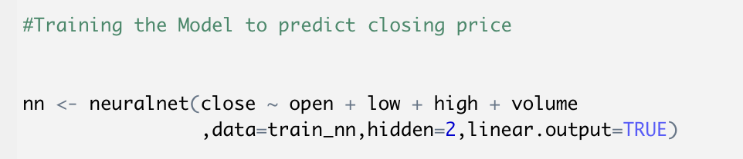
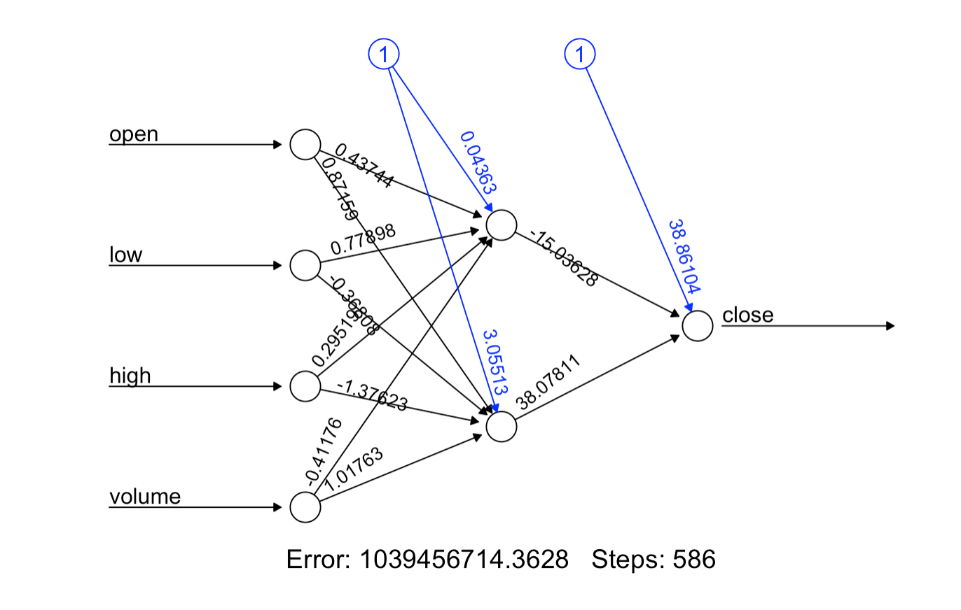
Model Preparation : Neural Network
Training the model with numeric variables as predictors, and using two hidden layers
MSE: 2205.179
R squared: -0.06
Negative Rsq means model's predictions are worse than a constant function that always predicts the mean of the data
Not suitable for this dataset

Slide 15
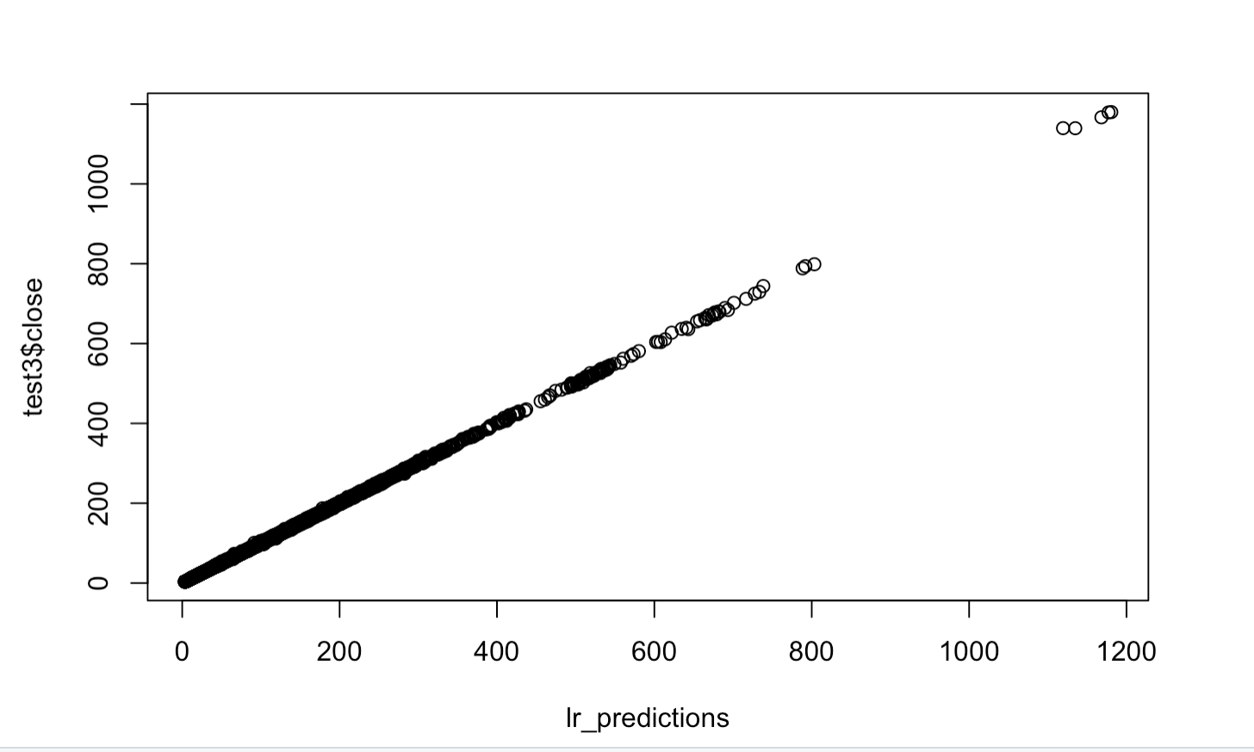
Model Preparation : Linear Regression
Result & Evaluation
Training the model with numeric variables as predictors
MSE: 0.2199
R squared: 0.99989
Low MSE and high R square indicate that its suitable for our dataset

Slide 16
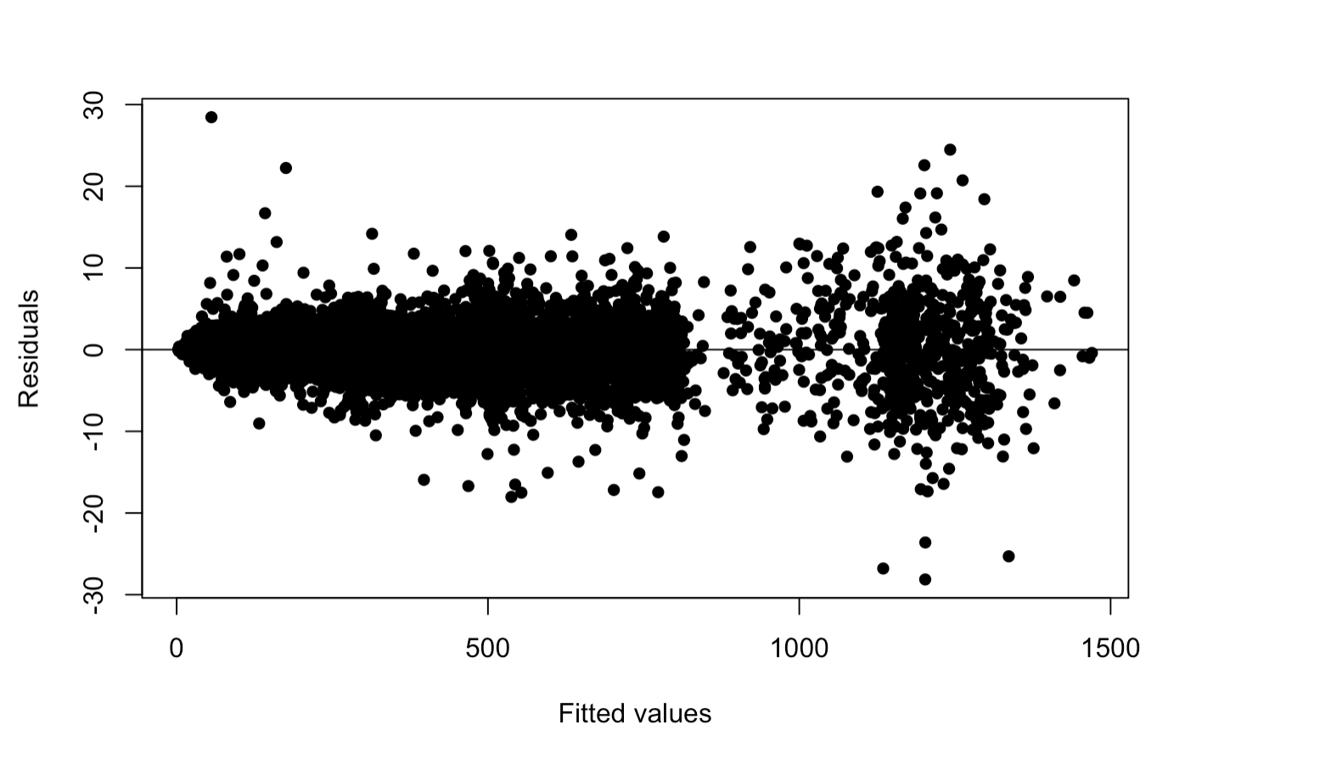
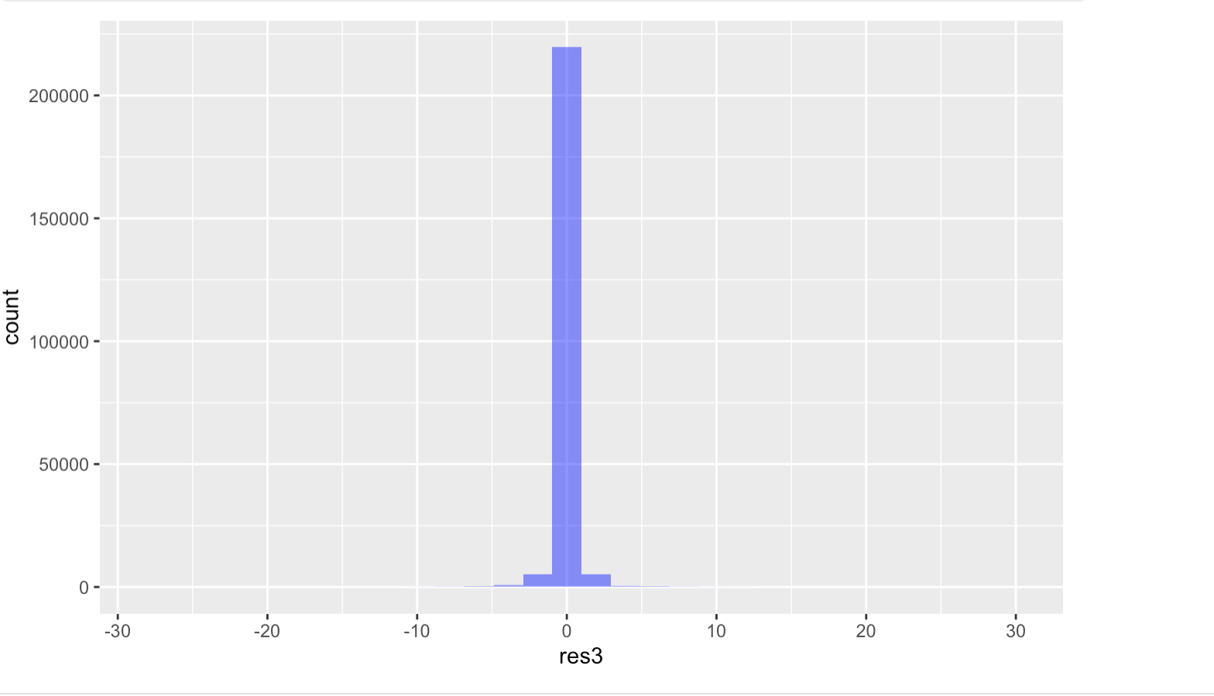
Model Preparation : Linear Regression
Residual Plot
Randomly scattered around 0
Not too centered
Good fit

Slide 17
Model Results: Summary
Results: Overall, the linear regression was the best model to use for the New York Stock Exchange dataset as it had the lowest MSE and yielded the closest results to actual values.
Model | MSE | R Squared
Linear Regression | 0.2199 | 0.99989
Neural Network | 2205.18 | -0.06
Decision Tree | 122.84 | 0.956
Lasso Regression | 7.053108 | 0.9989964
Ridge Regression | 366908.4 | -51.21

Slide 18
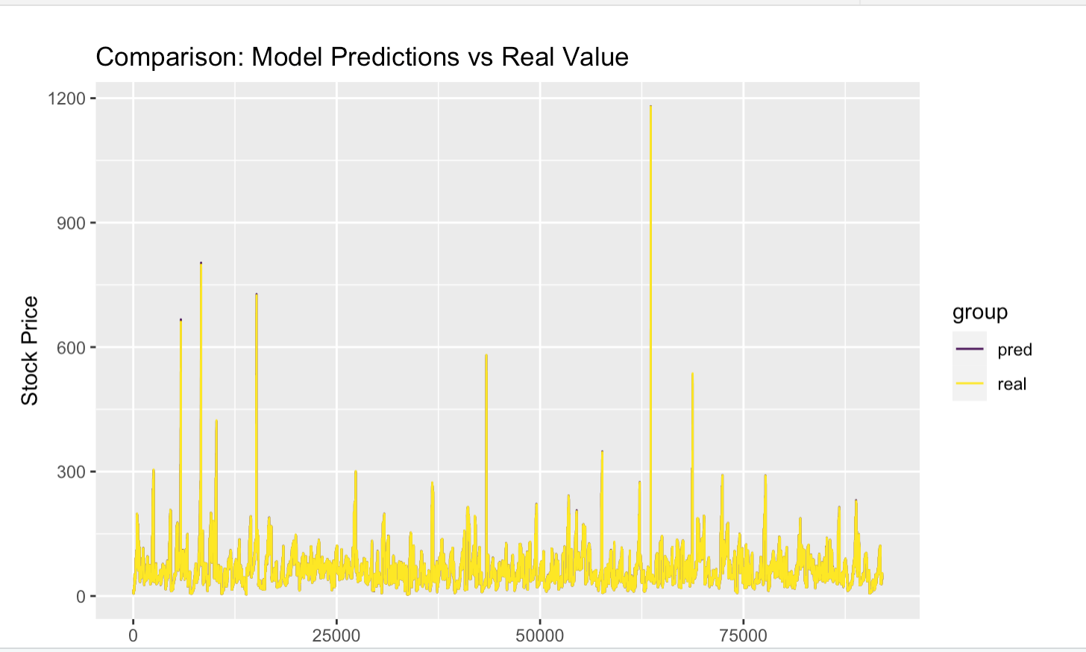
Conclusion
Model Summary & Results: Comparison Graph

Slide 19
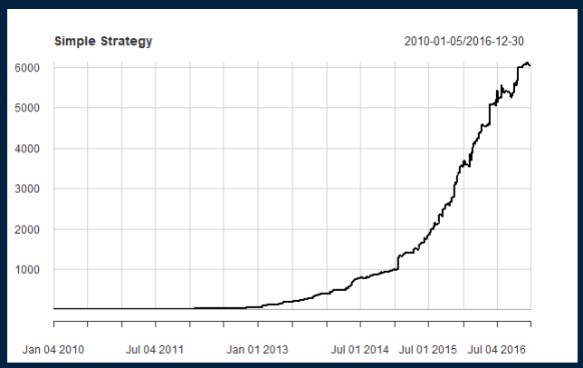
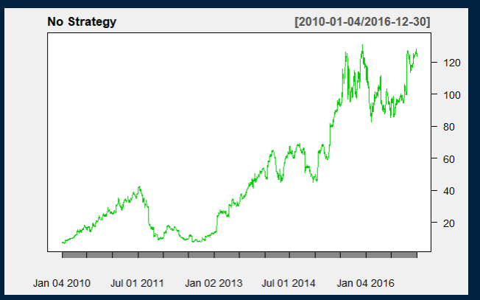
Best performing Stock
The criteria for best performing stocks would be the last closing price minus the first opening price divided by the last closing price.
Using those 10 best performing stocks we can perform a simple trading strategy where we buy at the open and sell at the close. Our trading signal would be then be whether the price increased by 5% since the last closing, this is so we can maximize our earning and avoid downturns in the market.
This chart shows us the performance of $1 based on the strategy of only trading only if the price increases by 5% from the previous closing.
This basically tells us that having even a basic strategy when investing yields better results than without because not all stocks perform as well as NFLX.

Slide 20
Thank You

